Slide 1
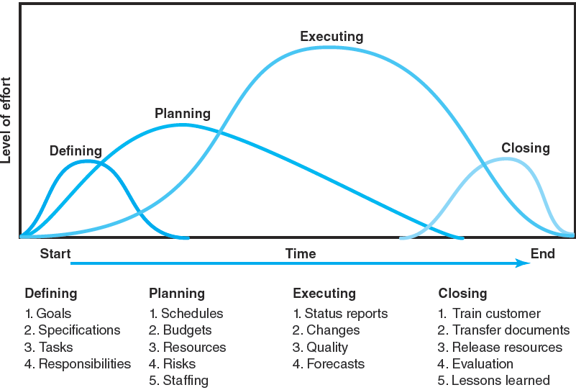
Project Life Cycle
FIGURE 1.1
Notes:
FIGURE 1.1 Project Life Cycle
Figure 1.1 illustrates the typical four sequential stages of a project’s life cycle in terms of its limited life span and the changes in level of effort and focus over time. The project life cycle passes through four stages: defining, planning, executing, and delivering. As depicted in the figure, project effort starts slowly, builds to a peak, and then declines to delivery of the project to the customer.
1. Defining stage: Specifications of the project are defined; project objectives are established; teams are formed; major responsibilities are assigned.
2. Planning stage: Plans are developed to determine what the project will entail, its schedule, whom it will benefit, the quality level to be maintained, and its initial budget.
3. Executing stage: The physical product is produced (a bridge, a report, a software program). Time, cost, and specification measures are used to control scheduling, budgeting, change specifications and forecasts
4. Closing stage: Delivering the project product to the customer may include customer training and transferring documents. Resources are redeployed to other projects and team members are reassigned. Post-project reviews include assessing performance and capturing lessons learned.

Slide 2
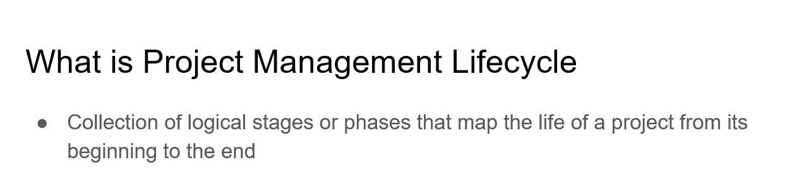
Advantages vs Disadvantages
Stakeholders are on the same page before moving to the next stage
Resources are defined early
Evaluation of a project
Effectiveness
Cost-benefits
Overlapping of project phases increases risk
Schedule restrictions across an organization
Feedback availability
Fluctuation in cost throughout the project
Feature changes

Slide 3
Best Practices
Have a definite project end
Get approval from stakeholders along the way
Define specific goals
The goal should answer the question, “How will we know if this project is successful?”
Both large and small projects should include phase-end reviews
“Fast tracking” - a process where the next phase starts before the current phase is finished, is risky and generally best avoided

